Slide 1
Analysis and Feasibility Study of a fully
Decentralized Network
Department of Computer Science & Engineering
The Oxford College of Engineering
Authors:
Rahul Jain
Meghana GM
Poorna C
Naveena P
Guide:
Ms. Chandanita Chaterjee

Slide 2

What is Internet?
A Global computer network providing a variety of information and communication facilities, consisting of interconnected networks using standardized communication protocols.

Slide 3
Structures of the Internet
Centralized – A server / central control point based networking structure.
Distributed – A networking structure that consists of multiple servers spread across the whole network.
Decentralized – A peer – peer networking structure with complete eradication of servers.

Slide 4
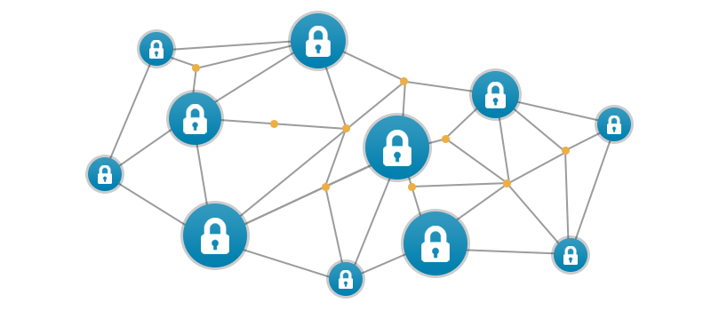
Feasibility Study
The initial structure of the internet was Decentralized (ARPANET).
Crypto-Networks.
The Matrix Topology.
Rise of various Decentralized Applications and Platforms

Slide 5
Implementation - 1
Blockchain: A distributed networking protocol shows that robust, secure infrastructure doesn’t need central authorities or servers.
Enabled by Crypto-Economic networks, a generalization of the ideas first introduced in Bitcoin and further developed in Ethereum. Cryptonetworks combine the best features of the first two internet eras

Slide 6
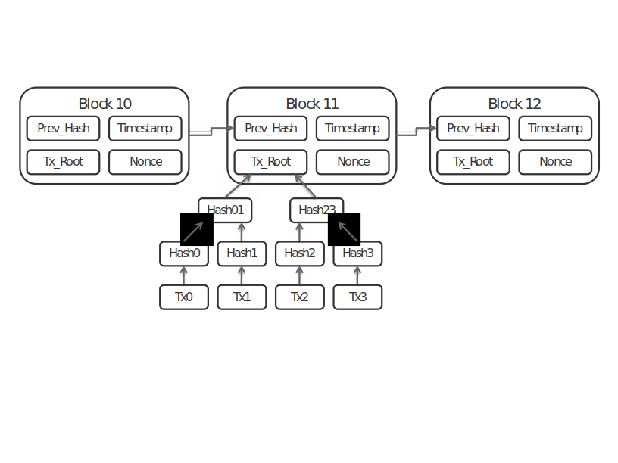
Blockchain
Prev_Hash: hash value of previous block.
Tx_root: root hash value of a hash tree (w:merkle tree) over all transactions.
Timestamp: creation time of block, as seen by block creator.
Nonce: any number to make sure the resulting hash value of this block is below the target hash value. The Nonce is a 32 bit number and the 2^32 number space is exhausted during mining within less than a second.
The transactions (Tx0, Tx1, ...) are appended to the block.

Slide 7
Matrix Topology
Matrix is an open standard for interoperable, decentralised, real-time communication over IP. It can be used to power Instant Messaging, VoIP/WebRTC signalling, Internet of Things communication - or anywhere you need a standard HTTP API for publishing and subscribing to data whilst tracking the conversation history.
Matrix defines the standard, and provides open source reference implementations of Matrix-compatible Servers, Clients, Client SDKs and Application Services to help you create new communication solutions or extend the capabilities and reach of existing ones.

Slide 8
Comparison - Pros
Centralized
The main benefits of a centralized Internet are government authorities that can spy on the common but mandatory points through which data has to pass before it goes to the recipients.
Everything is in the charge of the provider He needs to ensure that he can assure enough bandwidth for all the user to be able to download the file in a reasonable time.
Simplicity.
Decentralized
Lower latency
Cheaper data transfer costs (possibly)
Resilience
Local support in the customer’s time zone is easier
lower cost

Slide 9
Comparison - Cons
Centralized
The possibility of a complete failure is a major concern for networks that use a centralized scheme.
Centralized systems require users to access information on the network uniformly using the same processes.
Security is a critical component of any network system. Centralized systems create centralized targets.
Decentralized
Design OverHead.
Security Risks.
Impossible to Reverse-Fraud.
No place for Government Regulation

Slide 10
Feasibility - Applications
BlockStacks
Storj
IPFS - InterPlanetary File System
Solid - Solid (derived from "social linked data")
Torrent.

Slide 11
Conclusion
Decentralized Internet can be identified using peer to peer connections rather than using a single point network access without having to go through a mandatory point, at most the ISP can gather data on the net. In the current centralized model, since the data is made to pass through certain points, anyone with authority can scan the data.
Hence, Decentralized internet provides security, freedom and reliability.

Slide 12
Questions?

Slide 13
Thank You.
Rahul Jain
Meghana GM
Poorna C
Naveena P

